Slide 1


WICSE SHADOWING MIDTERM PRESENTATION
Zoe Brown

Slide 2
Introduction
Mentor: Karina Alverez Silverstein
Year: 3rd year
Major: Computer Science
Minor: Digital Arts and Science

Slide 3

Overview
Research Question:
How can I sync data between a non-relational database and a relational database with as little time complexity as possible to be highly performant

Slide 4

Overview
Goal:
Identify methods / techniques to sync 2 different data stores:
Real time
0% data loss in replication
Balance and control measures

Slide 5




Overview
Technology:
Couchbase (Non-relational DB)
PostgreSQL (Relational DB)
Python
Vue.js

Slide 6
Prior Experience
No previous knowledge of databases (at all)
No previous knowledge of industry implementation techniques
Very little web-development

Slide 7
Progress
2 Weeks
2 weeks
Set up
Syncing
Research
Learning
1 week
2 weeks

Slide 8
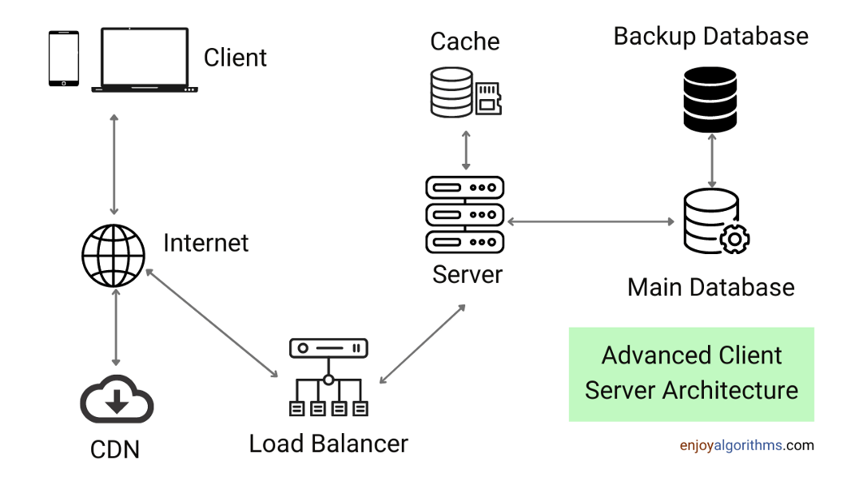
Progress
Set up
Syncing
Research
JUPITER
NEPTUNE
Difference between Non-relational and Relational databases
Load balancing and Latency
Client-Server architecture

Slide 9
Progress
Set up
Syncing
JUPITER
NEPTUNE
Install Couchbase as a local server
Install PostgreSQL as a local server
Set up python for scripting
Connect to both servers
Set up

Slide 10
Progress
Set up
Syncing
JUPITER
NEPTUNE
CRUD operations for Couchbase
CRUD operations for PostgreSQL
Understanding key-value pairs/tables
Inserting CSV
Learning

Slide 11
Progress
Set up
Syncing
JUPITER
NEPTUNE
Push to CB and PG separately
Push to non-relational first then cascade to relation
Push to relation first then cascade to non relational
Syncing

Slide 12
Personal Development Status
New understanding and appreciation of industry tools
New interest in database techniques and intricacies
Baseline knowledge increase due to research

Slide 13




Challenges
UNDERSTANDING
SETUP
STARTING
TIME
First time using databases
Lots of configurations
What tools/information do I need?
Balancing work

Slide 14
Future Plans/Goals
01
02
03
Research ways to deal with latency
Setup front-end (Vue.js)
Test and Optimize
Kafka Connect?
Web app to do the push and insert data
Max latency goal of 500ms

Slide 15
Thank you!

